Slide 1
Software Engineering

Slide 2
TYPES OF REQUIREMENTS
We can divide requirements into five types
Functional requirements
Non-functional requirements
External interfaces
Physical product Requirements
Development constraints

Slide 3
FUNCTIONAL REQUIREMENTS
Functional requirements are those behaviors that the developed product should do or support.
These are usually expressed as inputs into the product, outputs of the product, or a description of the behavior itself.

Slide 4
FUNCTIONAL REQUIREMENTS[contd..]
For example, input might be data related to a user’s online purchase, including name, address, item purchased, and payment information.
The output in this scenario might be a notification email after the transaction is performed.

Slide 5
FUNCTIONAL REQUIREMENTS[contd..]
Information flow diagrams are a graphical technique commonly used to show how data flows within a system.

Slide 6
FUNCTIONAL REQUIREMENTS[contd..]
The following is an example of an information flow diagram
A customer uses a credit card with a product
The credit card information is verified before a receipt is generated for the user.

Slide 7
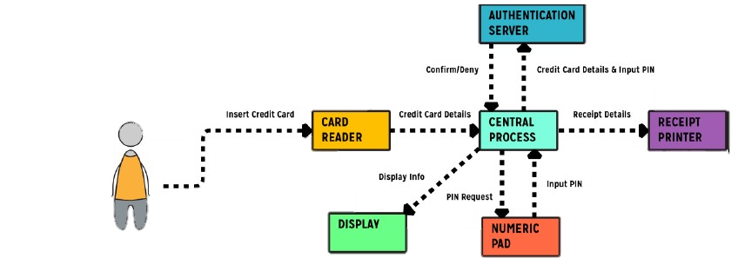
FUNCTIONAL REQUIREMENTS[contd..]

Slide 8
FUNCTIONAL REQUIREMENTS[contd..]
Functional Requirements include
Business requirements
Business rules
User requirements

Slide 9
Business requirements
Those requirements that involve the purpose of the project.
For Example, The client needs to reduce errors in orders made to their company by 25% by the end of next year to raise their yearly revenue by $10,000

Slide 10
Business requirements [contd..]
Business requirements should not be confused with business rules, although they are often associated.
Business requirements deal with why the project was pursued, while business rules are constraints on how the product will function.

Slide 11
Business requirements [contd..]
Business rules are sometimes necessary to make a project appropriate or successful.
They are often budgets, policies, guidelines, or regulations

Slide 12
Business requirements [contd..]
Examples of business rules include:
Government or legal regulations
Privacy policies
Brand uniformity requirements
Student shall be struck off from role if GPA is Less than 2.0 is two continuous semester

Slide 13
User Requirements
Users or end-users are the people who will use the software once it has been created.
User requirements are the tasks that these users can accomplish with the product, or what the product can do for the user.

Slide 14
User Requirements [contd..]
They are part of the core functionality of the product.
For this reason, determining user requirements is usually very time consuming

Slide 15
User Requirements [contd..]
Many methods for expressing user requirements, including:
Use cases.
User stories.
Storyboards.
Scenarios.

Slide 16
Types of Requirements
We can divide requirements into five types
Functional requirements
Non-functional requirements
External interfaces
Physical product Requirements
Development constraints

Slide 17
Non-Functional requirements
Non-Functional requirements describe how well a product must perform.
Also known as quality requirements for this reason.
Address product issues including accuracy, dependability, security, usability, efficiency, performance, and maintainability.

Slide 18
Non-Functional requirements [contd..]
Drawing on the online purchasing example used in functional requirements, a non-functional requirement in the same scenario would be that emails should be delivered to users within two hours of purchase.
Non-functional requirements are usually complementary to functional requirements.

Slide 19
Types of Requirements
We can divide requirements into five types
Functional requirements
Non-functional requirements
External interfaces
Physical product Requirements
Development constraints

Slide 20
External Interfaces
Requirements related to how the product is situated within a larger system.
No concern with the physical environment of the product
Concerned with the relationship of the product to other entities outside the product.

Slide 21
External Interfaces [contd..]
For example, a software application that retrieves information from a remote database to display to users sits between the entities of the database and the end-user.
An external interface is used between each one.

Slide 22
Types of Requirements
We can divide requirements into five types
Functional requirements
Non-functional requirements
External interfaces
Physical product Requirements
Development constraints

Slide 23
Physical Requirements
How the product needs to be designed in order to function in its physical environment.
For example, if a product was being developed for underwater exploration, it would need to be waterproof.

Slide 24
Types of Requirements
We can divide requirements into five types
Functional requirements
Non-functional requirements
External interfaces
Physical product Requirements
Development constraints

Slide 25
Development Constraints
Development constraints affect everything from implementation technology, conventions, documentation, and the process used to develop the product.

Slide 26
Development Constraints [contd..]
Refer to constraints related to creating the product, such as which devices or platforms will be supported, or how much memory, bandwidth, or processing power the product is limited to using.
Similarly, if the product was designed for use in the desert, or in Antarctica, it would need to withstand and function in those environments.

